Slide 1
Recipes Bank
MAP

Slide 2
Introduction

Slide 3
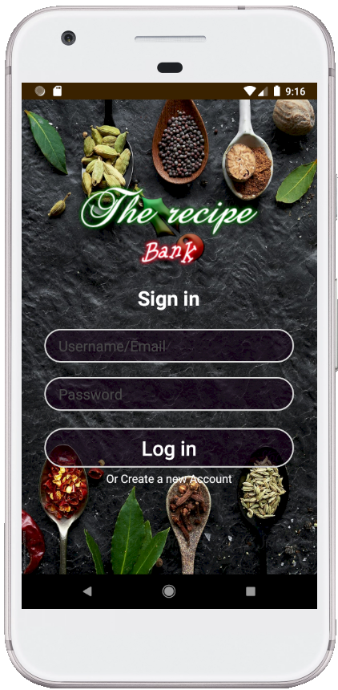
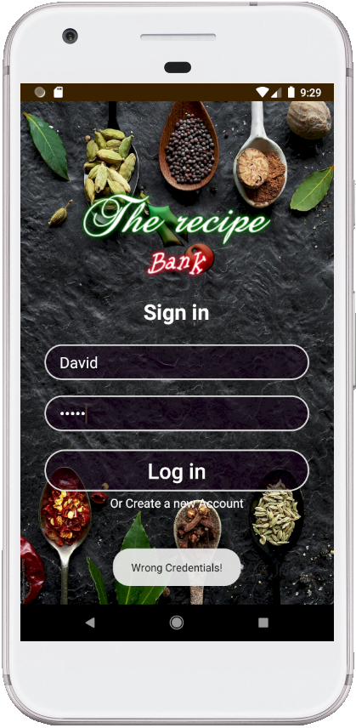
Figure1 shows the login page of the system. If the user signed in without having an account, “Wrong Credentials!” message shows up as in Figure 2.
Figure 1
Figure 2

Slide 4
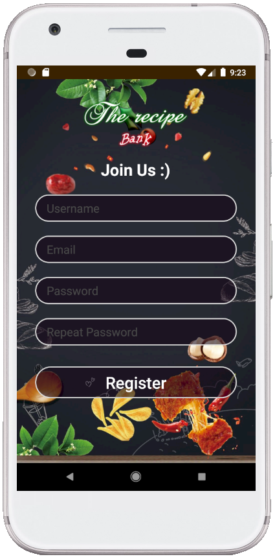
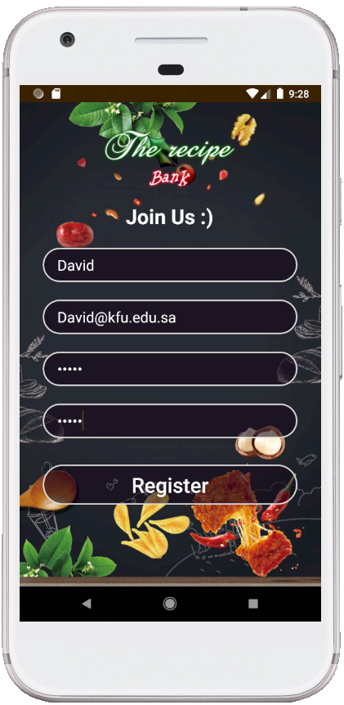
Registration page is shown in Figure 3. User enter his data as shown in Figure 4 to register into the system.
Figure 3
Figure 4

Slide 5
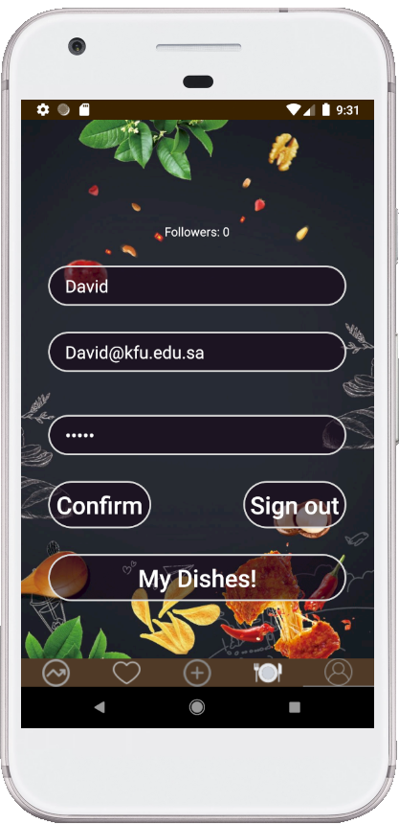
Profile page is shown in Figure 5.
Figure 5

Slide 6
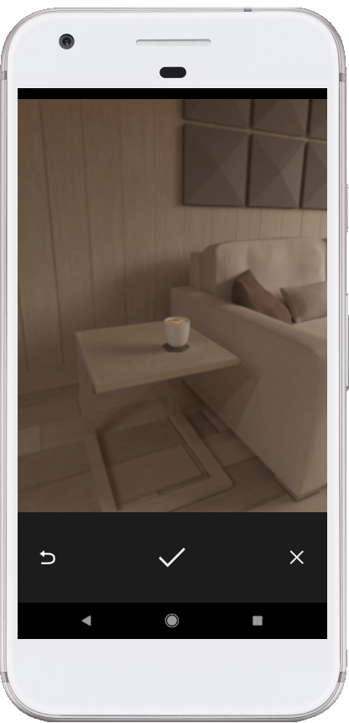
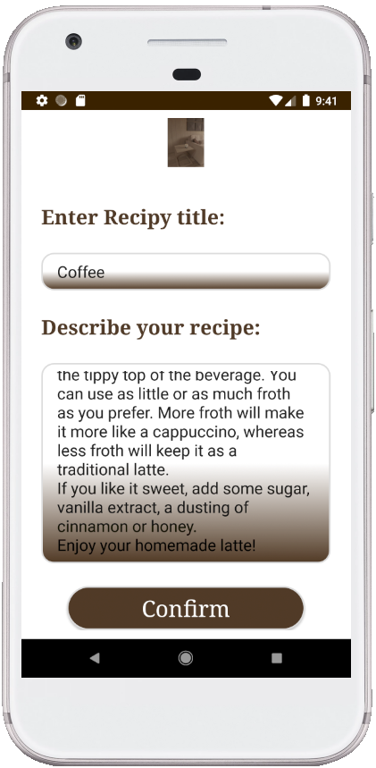
Creating new recipe user is required to take a photo of his recipe and then add a title and a description to it as show in Figure 6 and Figure 7.
Figure 6
Figure 7

Slide 7
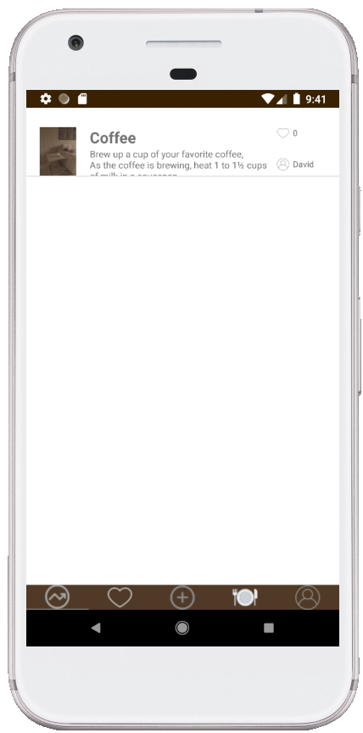
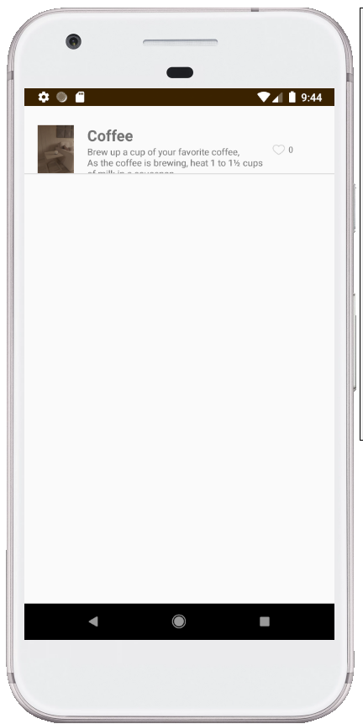
After the creation of the recipe is done successfully, the recipe will be added to the home page and “My Dishes” page as shown Figure 8 and Figure 9. it appears in “My Dishes” page for only the user who uploaded it.
Figure 8
Figure 9

Slide 8
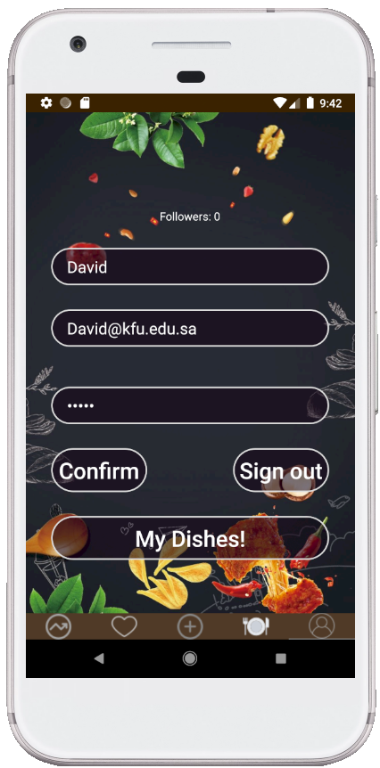
Figure 10 and Figure 11 shows how to access “My Dishes” page.
Figure 10
Figure 11

Slide 9
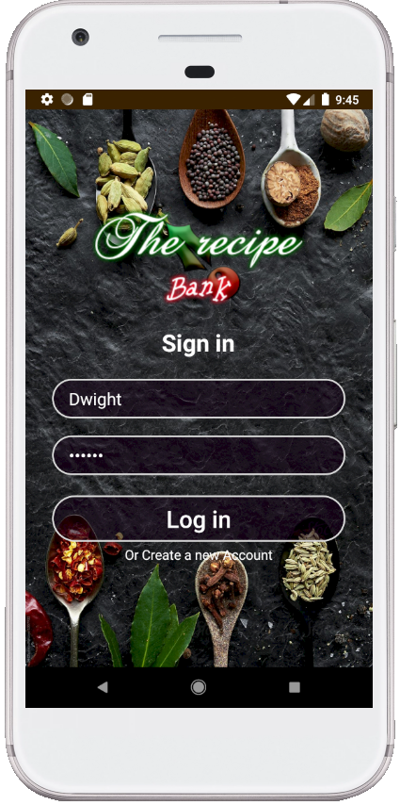
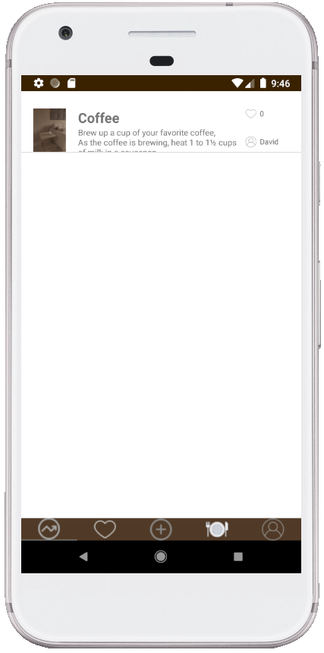
When signing in with another user account, the recipe of David will be shown there. Figure 12 and Figure 13 emphasize that.
Figure 12
Figure 13

Slide 10
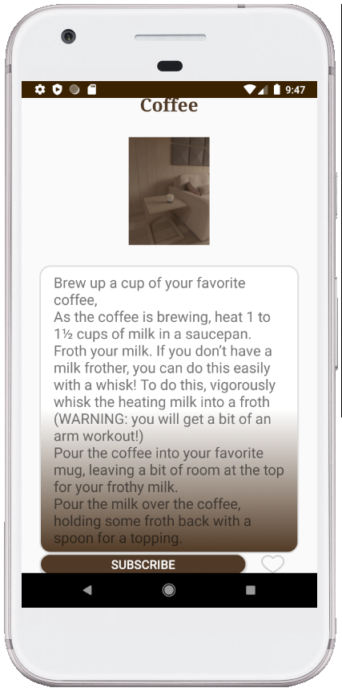
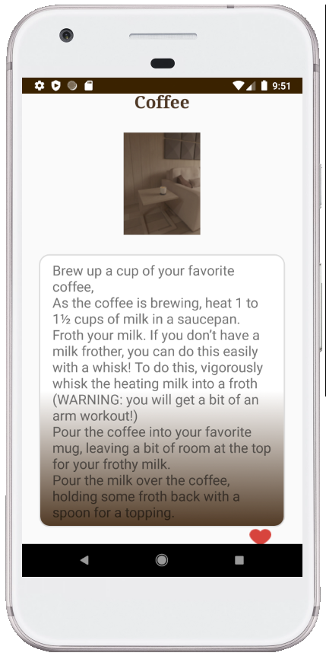
As Dwight logged in to the system, and clicked on David recipe “Coffee”, he is now able to view it, like it, and subscribe to him which enables him to look at all his recipes.
Figure 14
Figure 15

Slide 11
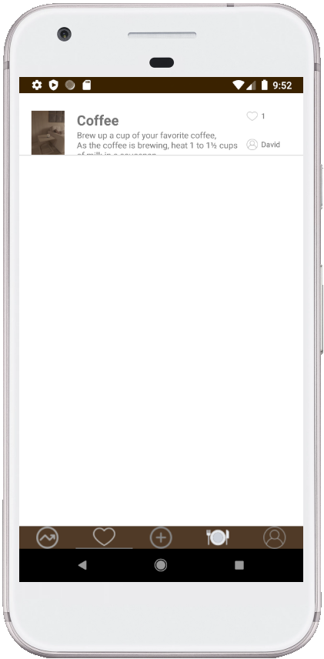
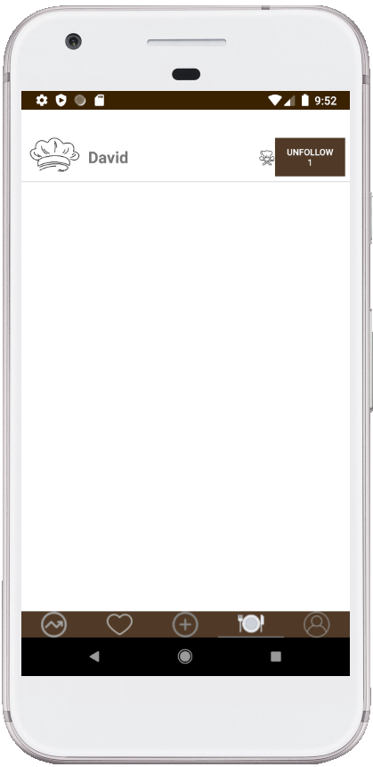
As Dwight subscribed to David and liked “Coffee” recipe, Coffee recipe is now in favorite list and David is added to the subscribed list.
Figure 16
Figure 17

Slide 12
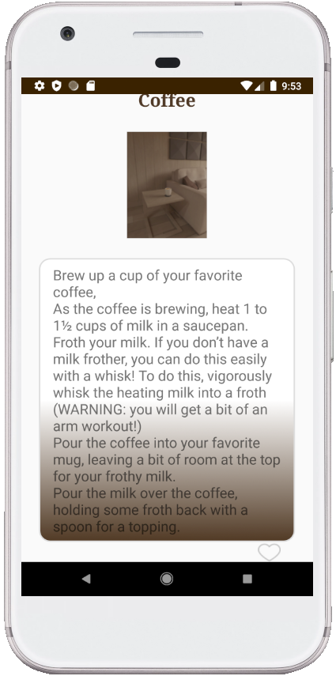
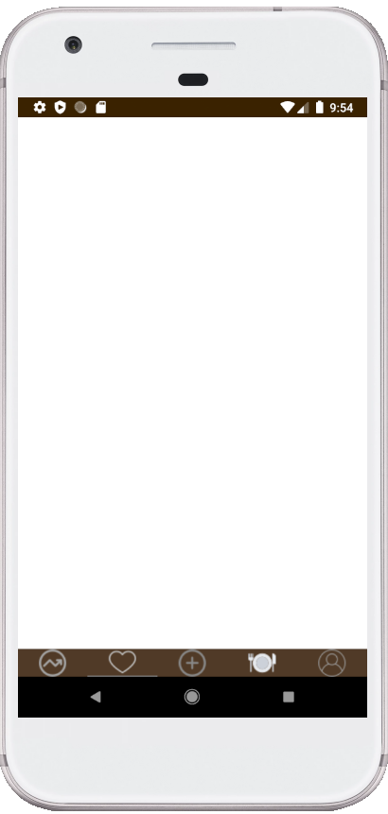
Now if, Dwight removed the like from David Recipe, the recipe will be removed from Dwight favorite list.
Figure 18
Figure 19

Slide 13
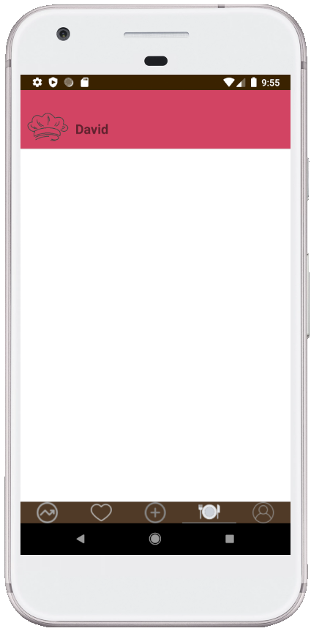
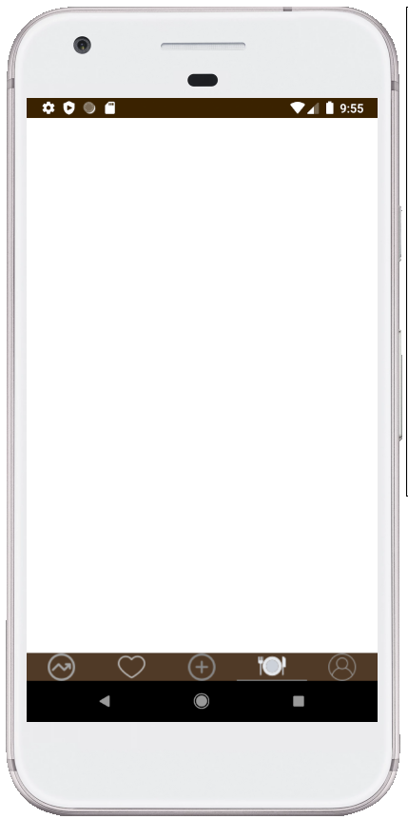
Now if, Dwight removed the subscription from David, David will be removed from Dwight subscriptions list.
Figure 20
Figure 21

Slide 14
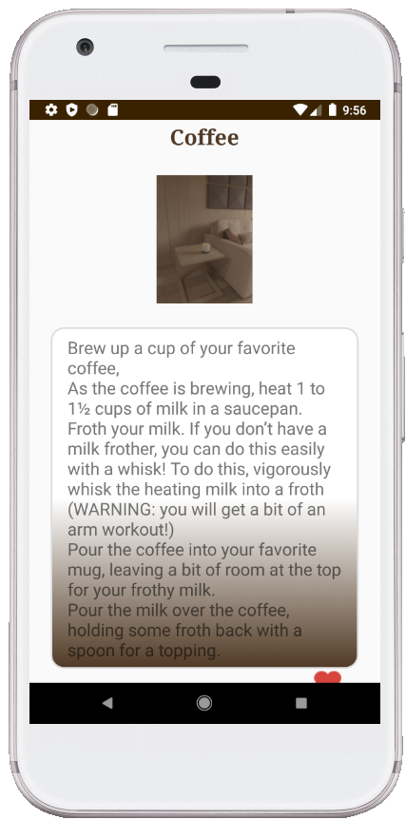
Now, if Dwight did not unsubscribe David and did not remove the like button, David page will be shown as next
Figure 22

Slide 15

David now is able to see the number of his followers in the profile page
Figure 23

Slide 16
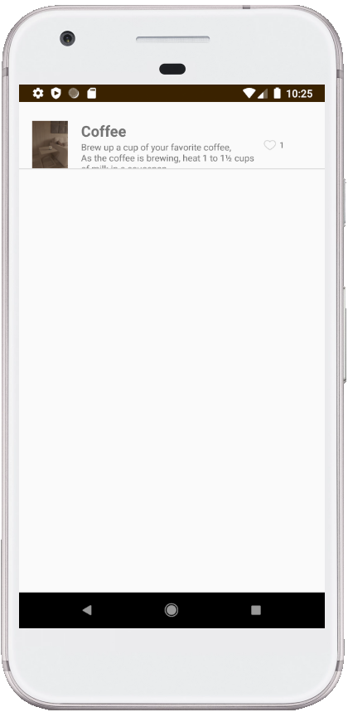
David now is able to see the number of likes on his recipe “Coffee”.
Figure 24

